Slide 1
Greek Adjectives and Pronouns with 3- and 2-endings
Prof. Vanessa Gorman
University of Nebraska-Lincoln
vgorman1@unl.edu

Slide 2
Remember
Adjectives match the noun they modify in gender, number, and case
Adjectives do not necessarily have the same endings as the nouns they modify, because they also follow the three declensions

Slide 3
3-ending adjectives follow the pattern of the 1st and 2nd declensions
 | Sing Masc | Sing Fem | Sing Neut |  | Plur Masc | Plur Fem | Plur Neut
Nom | καλός | καλή | καλόν |  | καλοί | καλαί | καλά
Gen | καλοῦ | καλῆς | καλοῦ |  | καλῶν | καλῶν | καλῶν
Dat | καλῷ | καλῇ | καλῷ |  | καλοῖς | καλαῖς | καλοῖς
Acc | καλόν | καλήν | καλόν |  | καλούς | καλάς | καλά

Slide 4
 | Sing Masc | Sing Fem | Sing Neut
Nom | ὁ καλός πολίτης | ἡ καλή ἡμέρα | τὸ καλόν χωρίον
Gen | τοῦ καλοῦ πολίτου | τῆς καλῆς ἡμέρας | τοῦ καλοῦ χωρίου
Dat | τῷ καλῷ πολίτῃ | τῇ καλῇ ἡμέρᾳ | τῷ καλῷ χωρίῳ
Acc | τὸν καλόν πολίτην | τὴν καλήν ἡμέραν | τὸ καλόν χωρίον
 | Plur Masc | Plur Fem | Plur Neut
Nom | οἱ καλοί πολῖται | αἱ καλαί ἡμέραι | τὰ καλά χωρία
Gen | τῶν καλῶν πολιτῶν | τῶν καλῶν ἡμερῶν | τῶν καλῶν χωρίων
Dat | τοῖς καλοῖς πολίταις | ταῖς καλαῖς ἡμέραις | τοῖς καλοῖς χωρίοις
Acc | τοὺς καλούς πολίτας | τὰς καλάς ἡμέρας | τὰ καλά χωρία

Slide 5
Position of the Adjective
Attributive position [has the article immediately preceding it]
“The beautiful days” or just “beautiful days”
article – attribute – noun [αἱ καλαί ἡμέραι]
article – noun – article – attribute [αἱ ἡμέραι αἱ καλαί]
noun – article – attribute [ἡμέραι αἱ καλαί]
Predicate position [does not have the article immediately preceding it]
αἱ ἡμέραι καλαί ἦσαν = “The days were beautiful.”
καλαί αἱ ἡμέραι ἦσαν = “Beautiful were the days.” [emphasis]
αἱ ἡμέραι καλαί = “The days are beautiful.” [verb “to be” elided]

Slide 6
Substantive Adjectives
Adjectives may stand alone with an article as substantives
If this happens often enough, they may be treated as nouns or adjectives.
ὁ φίλος, ὁ σύμμαχος, ὁ πολέμιος (friend, ally, enemy)
οἱ δʼ ἄριστοι ἐνίκων. (The nobles were winning.)
ὁ ἱερὸς ἔθυεν. (The priest was sacrificing.)

Slide 7
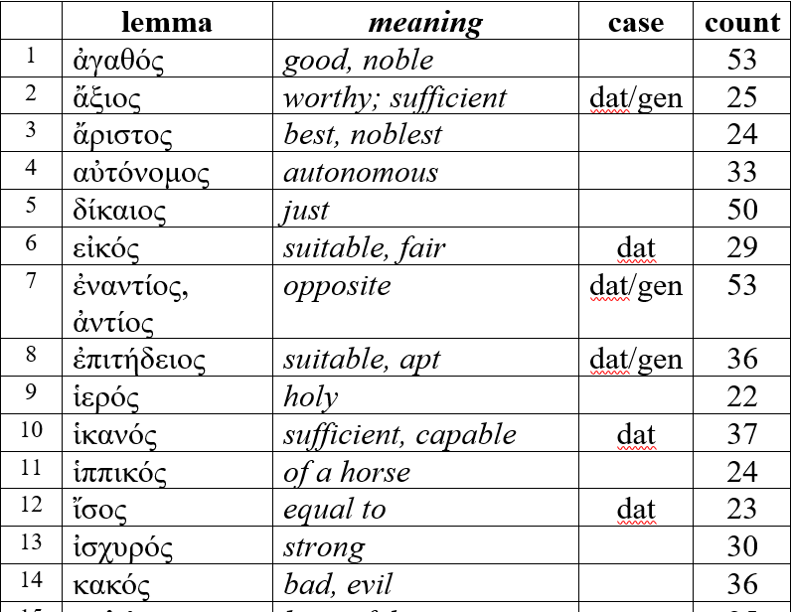
28 common 3-ending adjectives

Slide 8
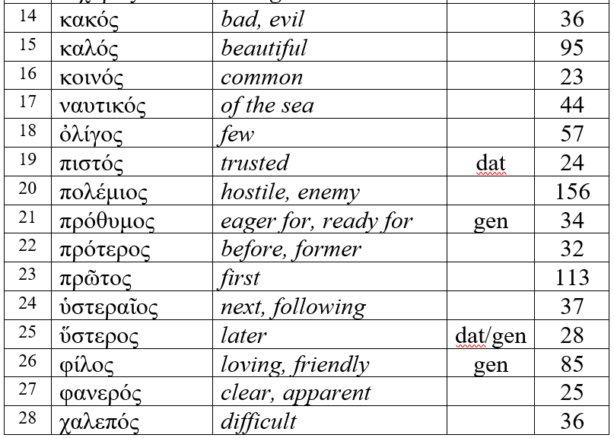
28 common 3-ending adjectives

Slide 9
Case Use After Adjectives
ὀλίγος takes a partitive genitive [ATR]
Few of them
ἄξιος, φίλος, πρόθυμος take an objective genitive [ADV]
Worthy of, loving of; eager of
ἐναντίος/ἀντίος, ἐπιτήδειος, and ἐχθρός take either a genitive or dative [ADV]
Opposite of, opposite to
Suitable for/of
Enemy of, hostile to

Slide 10
Case Use after Adjectives
πρότερος, ὑστεραῖος, ὕστερος usually take a genitive of comparison [ADV]
Previous to, later than
Sometimes a dative
Often used substantively, with something like ἡμέρᾳ assumed. [ADV]
τῇ δὲ ὑστεραίᾳ = on the next day
Or used in the adverbial accusative [ADV]
ὕστερον = later

Slide 11
2-ending adjectives
Usually compound adjectives: αὐτόνομος
Masculine and feminine both use masculine endings
ἄδικος = α-privative (“not”) + δίκος (“just”) = “unjust”
 | Sing Masc | Sing Fem | Sing Neut |  | Plur Masc | Plur Fem | Plur Neut
Nom | ἄδικος |  | ἄδικον |  | ἄδικοι |  | ἄδικα
Gen | ἀδίκου |  |  |  | ἀδίκων
Dat | ἀδίκῳ |  |  |  | ἀδίκοις
Acc | ἄδικον |  |  |  | ἀδίκους |  | ἄδικα

Slide 12
The first four cardinal numerals decline irregularly
One, three, and four we will encounter later
δύο [“two”] is usually indeclinable, though it admits of a dual form in the genitive and dative [δυοῖν]

Slide 13
Cardinal numerals from 5 to 199 are indeclinable
5 | πέντε |  | 13 | τρεισκαίδεκα
6 | ἕξ |  | 15 | πεντέκαίδεκα
7 | ἑπτά |  | 20 | *εἴκοσι(ν)
8 | ὀκτώ |  | 21 | εἷς καὶ εἴκοσι(ν)
9 | ἐννέα |  | 30 | *τριάκοντα
10 | *δέκα |  | 40 | τετταράκοντα
11 | ἔνδεκα |  | 50 | πεντήκοντα
12 | *δώδεκα |  | 100 | *ἐκατόν

Slide 14
Common Cardinal Numbers in Xenophon
 | lemma | meaning | case | count
1 | δέκα | 10 | indecl | 44
2 | δύο | 2 | indecl/dual | 41
3 | δυώδεκα | 12 | indecl | 22
4 | εἴκοσι | 20 | indecl | 34
5 | ἑκατόν | 100 | indecl | 31
6 | τριάκοντα | 30 | indecl | 48

Slide 15
Cardinal numerals above 200 decline like 3-ending adjectives
διακόσιοι, -αι, -α [200]
πεντακόσιοι, -αι, -α [500]
χίλιοι, -αι, -α [1,000]
μύριοι, -αι, -α [10,000]

Slide 16
All ordinal numerals decline like 3-ending adjectives
*πρῶτος, -α, -ον first [113x]
δεύτερος second
τρίτος third
τέταρτος fourth
πέμπτος fifth
ἕκτος sixth
ἕβδομος seventh
ὄγδοος eighth
ἔνατος ninth
δέκατος tenth
δωδέκατος twelfth
εἰκοστός twentieth
πεντηκοστός fiftieth
ἐκατοστός one hundredth
πεντακοσιοστός five hundredth
χιλιοστός one thousandth
μυριοστός ten thousandth

Slide 17
ὡς + number = roughly, about [AuxZ]
ὡς ἐκατόν = about a hundred

Slide 18
Review: Positions of Adjectives
Attributive = immediately following article [ATR]
αἱ καλαί ἡμέραι = the beautiful days
αἱ ἡμέραι αἱ καλαί = the beautiful days
Predicate = not following the article [PNOM]
αἱ ἡμέραι καλαί = the days are beautiful
καλαί αἱ ἡμέραι = the days are beautiful
Substantive = following article, but without a stated noun, and so acts as a noun
αἱ καλαί = the beautiful women

Slide 19
pronouns/adjectives
Demonstrative, reflexive, and qualifying adjectives and pronouns
 | lemma | meaning | Pron only | count
1 | ἀλλήλων | (of) one another | XX | 46
2 | ἄλλος | other, another |  | 355
3 | ἀμφότερος | both; either |  | 36
4 | αὐτός | he, same, self |  | 1277
5 | ἑαυτοῦ | (of) himself | XX | 190
6 | ἕκαστος | each |  | 79
7 | ἐκεῖνος | that man |  | 206
8 | ἕτερος | one or the other (of two) |  | 24
9 | μόνος | alone, only |  | 44
10 | ὅδε | this man |  | 40
11 | οὗτος | this man |  | 1022

Slide 20
Declension of demonstrative, reflexive, and qualifying adjectives and pronouns
Most are regular 3-ending adjectives
–ο in neuter nom/acc sg
αὐτός, αὐτή, αὐτό
ἐκεῖνος, ἐκείνη, ἐκεῖνο
No nominative
ἑαυτοῦ, ἑαυτῆς, ἑαυτοῦ (of himself/herself/itself)
ἀλλήλων (of each other)
ὅδε, ἥδε, τόδε is declined exactly like the article + δε

Slide 21
οὗτος, αὕτη, τοῦτο is declined like a regular 3-ending adjective, except in the nominative and the fem gen plur
 | Sing Masc | Sing Fem | Sing Neut
Nom | οὗτος | αὕτη | τοῦτο
Gen | τούτου | ταύτης | τούτου
Dat | τούτῳ | ταύτῃ | τούτῳ
Acc | τοῦτον | ταύτην | τοῦτο
 | Plur Masc | Plur Fem | Plur Neut
Nom | οὗτοι | αὗται | ταῦτα
Gen | τούτων | τούτων | τούτων
Dat | τούτοις | ταύταις | τούτοις
Acc | τούτους | ταύτας | ταῦτα

Slide 22
Demonstratives can act as either adjectives or pronouns
Often just 3rd person personal pronoun = “he/she/it/they”
ἔπεμψαν αὐτοὺς εἰς Λακεδαίμονα. [2.2.12]
Remember, the article can act as a pronoun as well.
οἱ δὲ ταῦτα ἐποίησαν. [2.1.27]
Common idioms
μετὰ δὲ ταῦτα = afterwards
μετὰ δὲ ταῦτα Τισσαφέρνης ἦλθεν εἰς Ἑλλήσποντον. [1.1.9]
οἱ δὲ μετʼ αὐτοῦ or οἱ μὲν περὶ Λύσανδρον
= the ones with him or the ones with Lysander
οἱ δὲ μετʼ αὐτοῦ ἔφυγον. [1.1.18]

Slide 23
pronouns/adjectives
Demonstrative, reflexive, and qualifying adjectives and pronouns
 | lemma | meaning | Pron only | count
1 | ἀλλήλων | (of) one another | XX | 46
2 | ἄλλος | other, another |  | 355
3 | ἀμφότερος | both; either |  | 36
4 | αὐτός | he, same, self |  | 1277
5 | ἑαυτοῦ | (of) himself | XX | 190
6 | ἕκαστος | each |  | 79
7 | ἐκεῖνος | that man |  | 206
8 | ἕτερος | one or the other (of two) |  | 24
9 | μόνος | alone, only |  | 44
10 | ὅδε | this man |  | 40
11 | οὗτος | this man |  | 1022

Slide 24
Reflexive pronoun = ἑαυτοῦ
The pronoun refers to the subject of the verb of its clause
You should bring it to myself = WRONG
He led the army himself = CORRECT
ἑαυτοῦ acts as the 3rd person reflexive pronoun
3-ending adjective with no nominative form
Can be contracted to αὑτοῦ with rough breathing
For the nominative, use αὐτός in the predicate position
ὁ θεός αὐτὸς = the god himself
αὐτὸς ὁ θεός = the god himself

Slide 25
αὐτός
In the predicate position, it means “self”
ὁ θεός αὐτὸς = the god himself
In the attributive position, it means “the same”
ὁ αὐτὸς θεός = the same god
When standing alone in the nominative, it emphasizes the subject
αὐτοὶ τὴν γῆν ἔσχον = They [the Athenians] held the land.
Emphasizes the unstated subject, Athenians. [Smyth 1206]
In oblique cases, it is merely the 3rd person pronoun.
ἔλιπον αὐτήν ἐν τῇ Καρίᾳ =They left her in Caria.

Slide 26
αὐτός
καὶ ὁ αὐτὸς στρατηγός μὲν ἀπέπλευσε εἰς Κύπρον.
And the same general sailed away to Cyprus.
καὶ ὁ στρατηγός μὲν ἀπέπλευσε αὐτὸς εἰς Κύπρον.
And the general himself sailed away to Cyprus.
καὶ αὐτὸς μὲν ἀπέπλευσε εἰς Κύπρον.
And he sailed away to Cyprus.

Slide 27
Don’t confuse ἀλλά [but] with ἄλλα [other things].

Slide 28
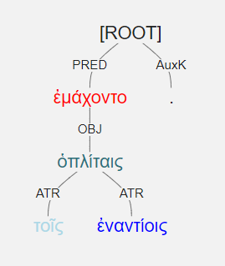
ἐμάχοντο τοῖς ἐναντίοις ὁπλίταις.

Slide 29
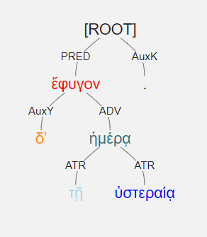
τῇ δʼ ὑστεραίᾳ ἡμέρᾳ ἔφυγον.

Slide 30
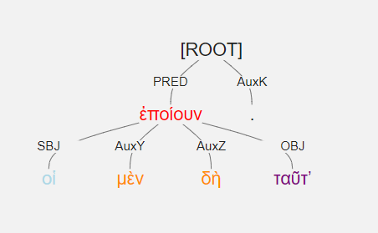
οἱ μὲν δὴ ταῦτʼ ἐποίουν.

Slide 31
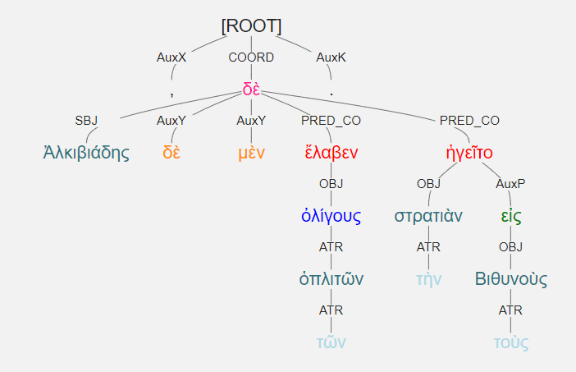
Ἀλκιβιάδης δὲ τῶν μὲν ὁπλιτῶν ὀλίγους ἔλαβεν, ἡγεῖτο δὲ τὴν στρατιὰν εἰς τοὺς Βιθυνοὺς.

Slide 32
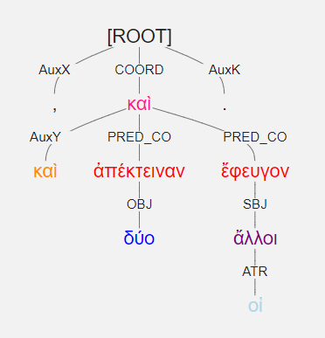
καὶ δύο ἀπέκτειναν, καὶ οἱ ἄλλοι ἔφευγον

Slide 33
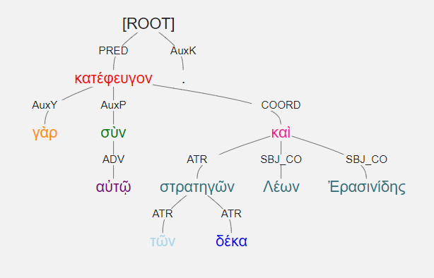
κατέφευγον γὰρ σὺν αὐτῷ τῶν δέκα στρατηγῶν Λέων καὶ Ἐρασινίδης.

Slide 34
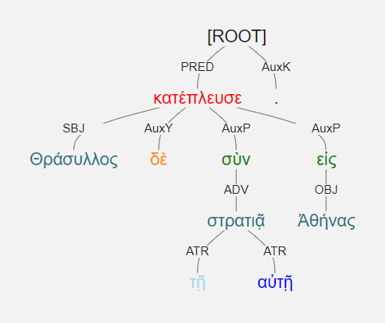
Θράσυλλος δὲ σὺν τῇ αὐτῇ στρατιᾷ εἰς Ἀθήνας κατέπλευσε.

Slide 35
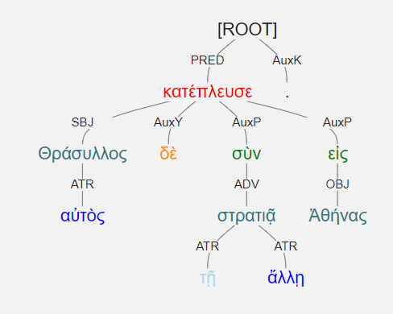
Θράσυλλος δὲ αὐτὸς σὺν τῇ ἄλλῃ στρατιᾷ εἰς Ἀθήνας κατέπλευσε.

Slide 36
Θράσυλλος δὲ σὺν τῇ αὐτῇ στρατιᾷ εἰς Ἀθήνας κατέπλευσε. Θράσυλλος δὲ αὐτὸς σὺν τῇ ἄλλῃ στρατιᾷ εἰς Ἀθήνας κατέπλευσε.

